Slide 1
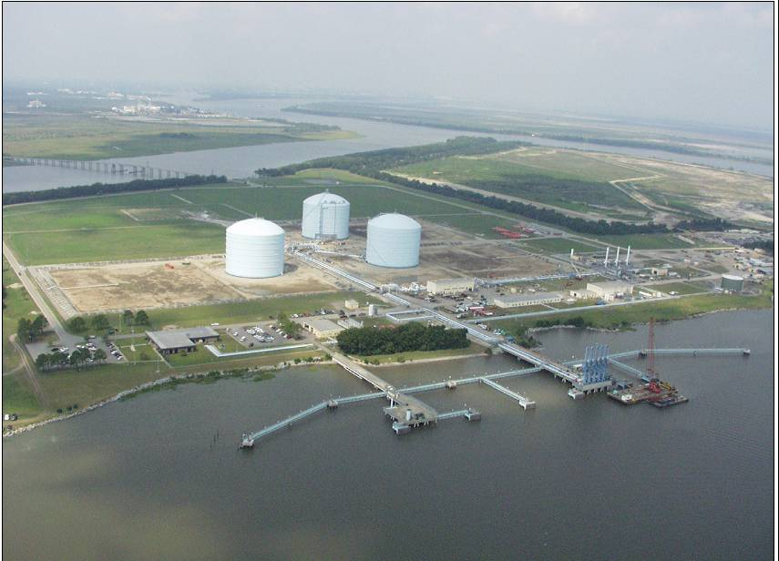
Liquefied Natural Gas Imports
Richard Foley, Case Manager
Office of Energy Projects
Federal Energy Regulatory Commission

Slide 2
Views of FERC Staff ONLY
NOTICE :
The views and information discussed herein are only attributable to the author (Richard Foley, FERC Staff), and does not necessarily represent the views or findings of the Commission or its individual members. This presentation is based on the best information available as of February 28, 2003.

Slide 3
Existing and Proposed LNG Import Terminals
* Top 25 *
Existing Terminals with Expansions
A. Everett, MA: 0.715 Bcfd (Tractebel)
B. Cove Point, MD: 1.0 Bcfd (Dominion)
C. Elba Island, GA: 1.2 Bcfd (El Paso)
D. Lake Charles, LA: 1.3 Bcfd (CMS Energy)
E. Guayanilla Bay, P.R.: 0.093 Bcfd (Eco Electrica)
Proposed Terminals – FERC
1. Hackberry, LA: 1.5 Bcfd, 2006 (Dynegy/Sempra)
2. Bahamas: 0.83 Bcfd, 2005 (AES Ocean Express – U.S.
Pipeline Only)
3. Bahamas: 0.83 Bcfd, 2005 (Calypso Tractebel – U.S.
Pipeline Only)
Proposed Terminals – Coast Guard
4. Port Pelican: 1 Bcfd, 2005 (Chevron Texaco)
5. Gulf of Mexico: 0.5 Bcfd, 2004 (El Paso Global)
Planned Terminals
6. St. John, NB: 0.5 Bcfd, 2005+(Irving Oil)
7. Fall River, MA: 0.4 Bcfd, 2006 (Weaver's Cove Energy)
8. Belmar, NJ Offshore : N/A, N/A (El Paso Global)
9. Bahamas: 0.5 Bcfd, 2005 (El Paso Sea Fare)
10. Tampa, FL: 0.5 Bcfd, 2005+(BP)
11. Freeport, TX: 0.55 Bcfd, 2005+(Cheniere LNG Partners)
12. Brownsville, TX: 0.55 Bcfd, 2006(Cheniere LNG Partners)
13. Corpus Christi, TX: 0.55 Bcfd, 2005+(Cheniere LNG Partners)
14. Altamira, Tamulipas: 0.5-1 Bcfd, 2004 (El Paso)
15. S. California Offshore: 0.5 Bcfd, 2005 (Chevron Texaco)
16. Baja California: 0.7 Bcfd, 2005 (El Paso)
17. Baja California: 1.0 Bcfd, 2005 (Marathon)
18. Baja California: 0.5 Bcfd, 2005 (Chevron Texaco)
19. Baja California: 1.0 Bcfd, 2005 (CMS Energy)
20. Los Angeles Harbor, CA: N/A, N/A (Mitsubishi)
6
A
7
8
B
15
20
C
18
9
17
1
D
10
2
3
16
13
11
19
4
5
12
14
E
January 2003

Slide 4
FERC Approval Process – ONSHORE ONLY
Economic Oversight of LNG Terminal Services:
Market Entry, Access, Rate Design,
Public Need / Public Interest
LNG Terminal Siting:
Safety, Security, Environment, Plant Design
Coast Guard – OFFSHORE ONLY
Deepwater Port Act Amended 2002
Department of Energy – COMMODITY
Authorization to import the LNG commodity
Based on US energy policy

Slide 5
Environmental Review
FERC
Approval
Process
Public Interest Review
Notice of Intent
Notice of Application
Scoping Meetings
& Site Visit
Interventions
Protests
Cryogenic Design &
Safety Review
Data Requests
Analysis
Agency Coordination
Data Requests
Analysis
Tech Conference
(Optional)
Preliminary Determination
(Optional)
DEIS
FEIS
Authorization

Slide 6
Authorizing Projects is a Balancing Act
Owners
Customers
Competitors
Landowners
Agencies
NGOs
Congress
NGA
NEPA/CEQ
  ESA
  NHPA
  CZMA
  DoT
FERC

Slide 7
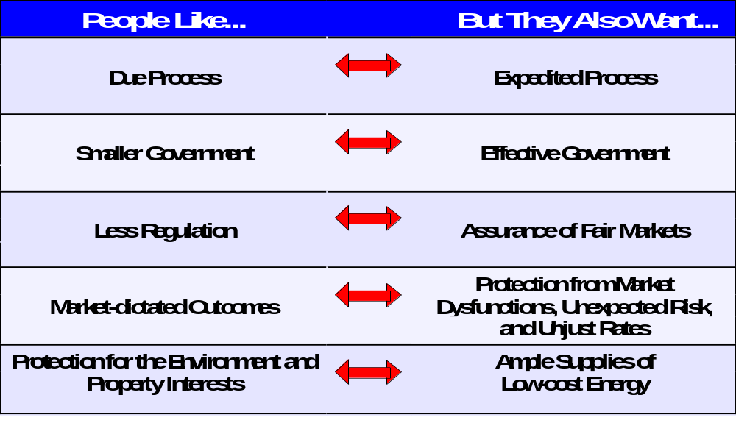
More Balancing . . .

Slide 8
Liquefied Natural Gas Imports
Economic Oversight

Slide 9
Natural Gas Act
Sec. 7 gives the Commission jurisdiction over transportation and sale for resale of natural gas in interstate commerce and construction and operation of facilities for that purpose.
Sec. 3 gives the Commission jurisdiction over siting and construction and operation of facilites for importing and exporting gas, and LNG is natural gas under the law.
Notes:
My topic focuses on the jurisdiction the FERC has over the siting of facilities for importing and exporting LNG. I will also briefly mention how FERC’s role might be affected by some pending legislation. But that’s the main the subject for Captain Brown from the Coast Guard who follows. So I’ll leave that topic for him.
If you are coming to this issue of FERC jurisdiction topic for the first time, it can be confusing. So let me start with a little background.
[READ SLIDE]

Slide 10
NGA Sec. 3 – Imports & Exports
DOE Reorganization Act - DOE approves imports and exports of the commodity
FERC approves place of entry or exit, siting, construction and operation of border crossing pipeline and LNG facilities
FEFC Reaffirms Jurisdictional Challenge
See Dynegy LNG Production Terminal, 97 FERC ¶ 61,231 (2001)
FERC Jurisdiction is “ Plenary and Elastic” See Distrigas Corp. v Federal Power Comm,495 F.2d 1057 (1974)
Notes:
Section 3 of the NGA is the source of the FERC’s jurisdiction over LNG. It has a long and somewhat circular history, though.
As written NGA § 3 says no person can import or export natural gas without an order from the commission allowing it to do so.
In 1977 the Dept of Energy Organization Act (§402(f), 42 U.S.C. § 7172(f)) transferred all section 3 functions from the Federal Power Commission to DOE.
But DOE has delegated back to FERC authority to approve the siting, construction, and operation of facilities for import and export, and where the import or export involves construction of new facilities, the place of entry or exit. DOE Delegation Order No. 0204-112 (1984).
As a result, DOE retains authority over the import or export of the commodity. The Commission regulates the siting and construction of the facilities.
Conveniently, you can find this and much more is discussed in a Commission order from last fall. In the recent Dynegy case, a company challenged the Commission’s jurisdiction over LNG facilities and asked for declaratory order. The Commission issued an order reaffirming it jurisdiction. That case, cited on the slide, is the latest Commission order addressing the issue.
[Dynegy claims 1) the Wellhead Decontrol Act deregulated first sales; 2) The Energy Policy Act declared that imports from a NAFTA country and all imports of LNG were first sales; 3) therefore the Commission does not have jurisdiction over LNG imports.]

Slide 11

Regulatory Approaches to the Commercial / Economic Function of LNG Terminals
Natural gas users of all sizes, marketers and “public utility” distribution systems
Major companies with foreign LNG supplies to sell on open world market
LNG
Terminal
Interstate Commerce – Section 7
Customer choice / open access “public
utility” system model
Traditional Cost-Based Rates or
Market-Based Rates
Full Open Access Tariff / Open Season
Certificate / Public Need Policy applies
Foreign Commerce – Section 3
International Proprietary LNG Supply
System Model
No Cost & Rate Oversight: Product
competes with unregulated domestic supply
Third Party Access at Operator’s Discretion
Certificate/Public Need Policy does not apply

Slide 12
Review of Open Access Policy for LNG
Docket No. PL02-9, Natural Gas Markets Conference (2002)
The Commission recognized that :
  LNG imports will be a key supply source in the U.S.
  It was time to reexamine existing open access policies and regulatory goals in order to remove unnecessary economic regulatory barriers to the development of LNG terminals.
  The Commission ruled in the Hackberry case that it would not exercise cost & rate oversight for the LNG terminal because the delivered LNG product competes with unregulated domestic supply.

Slide 13
Liquefied Natural Gas Imports
Siting, Safety, Security,
and the Environment

Slide 14
Elements of FERC Site Review
    Environmental Review under NEPA
    Cryogenic Design & Technical Review
    Post-Authorization Inspection Program

Slide 15
Environmental Document (EA or EIS)
Environmental Issues – endangered species, essential fish
habitat, wetlands, dredging, air emissions, and coastal
zone consistency
Safety Exclusion Zones – fires and flammable vapor clouds
from design spills
Marine Safety – Coast Guard operating plans, vessel traffic
congestion
Seismic Review – detailed facility analysis in high seismic
zones
Terrorism and Security – coordination with Coast Guard and
Office of Pipeline Safety

Slide 16
Cryogenic Design & Technical Review
  Design of plant equipment, instrumentation, and controls.
  Hazard detection, hazard control, and spill containment.
  Vapor cloud and radiation exclusion zones.
  Compliance with Department Of Transportation and National
  Fire Prevention Association safety requirements.
  Operational reliability and security.

Slide 17
Biennial LNG Site Inspections
  Physically inspect the condition of all major plant equipment
  Review plant operations, maintenance, and problems
  identified in semi-annual reports for prior 2 years
  Inspect changes in plant design, operations, and safety
  systems
  Inspect plant security measures
  Document findings in standard Cryogenic Design and
  Inspection Manual
  Investigate plant accidents

Slide 18
Liquefied Natural Gas Imports
What’s Getting Built

Slide 19
Four Countries – Planned, Filed, Approved, Financed, Built * Top 25
United States 16 projects
  FERC for onshore (12 projects)
  Coast Guard offshore (4 projects)
Mexico 5 projects
Bahamas 3 projects
Canada 1 project

Slide 20
Remote Siting vs. Market Area Locations
What is the Market and Where ?
  Winter heating load
  Summer cooling load
  New combined cycle power plants
  Replace Gulf Coast pipeline supply
Obstacles to Market-area siting :
  Greenfield sites – availability; land use/environmental
  compatibility; public concerns
  Brownfield sites – site and dredge spoil contamination;
  vessel traffic congestion
  Offshore sites – technology; pipeline landfall; now under
  Deepwater Ports Act amendments – Coast Guard

Slide 21
Onshore Mainland LNG Capacity
Existing LNG Terminals 530 Bcf/yr
(In service as of 2002)
Existing & Under Construction + 360
(Work progressing in 2003) 890 Bcf/yr
Existing, Under Construction,
inc. Preliminary Determinations + 655
(Final FERC action pending 2004 -05) 1,545 Bcf/yr

Slide 22
ONE GUY's Projection of LNG's Future in North America
(How to fill-up on LNG by 2012 – Tcf/yr)
Year Capacity Imports
2001-02 .530 .238
2004-05 1.0 1.0
2008-10 2.7 2.5 *
2012-15 3.7 3.5 *
* Given positive world energy / LNG price and supply assumptions.

Slide 23
DETAIL’s For ONE GUY's Projection of LNG's Future in North America ( by Richard Foley, FERC/OEP Staff )
25 to 30 Tcf Market * Optimistic / Realistic LNG share of market = 3 Tcf
Project Existing Include Capacity Include Planned 2001 2004 2008 2012
(Bcf/yr) Capacity Pending at FERC Capacity Volumes Volumes Volumes Volumes
Distrigas 90 - 100 90 - 100 90 - 100 90 100 100 100
Cove Point - 0 - 270 365 - 0 - 270 270 - 365 365
Elba Island 160 290 290 2.5 290 290 290
Lake Charles 270 360 360 146 360 360 360
Hackberry 525 525 - 0 - - 0 - 525 525
Onshore Gulf 200 - 0 - - 0 - 200 200
Bahamas 200 - 400 200 - 400 - 0 - - 0 - 200 - 400 200 - 400
Offshore Gulf 350 - 600 - 0 - - 0 - 350 - 600 350 - 600
Baja Mexico 365 - 500 - 0 - - 0 - 365 - 500 365 - 500
Other 365 - 0 - - 0 - - 0 - 365
T O T A L S 520 - 530 1.7 - 1.9 3.1 - 3.7 238.5 1.0 2.7-3.3 3.1-3.7
(Tcf/yr)
EcoElectrica 65 -130 65 -130 65 -130 22 50 75 75
Kenai/Cook Inlet ( 65 ) ( 65 ) ( 65 ) ( 65 ) ( 65 ) ( 65 ) ( 65 )

